Slide 1
Introduction to Bioinformatics
Lecture 2

Slide 2
Sequence Analysis

Slide 3
Sequence Analysis
DNA
RNA
Protein
Cells
Central dogma of biology

Slide 4
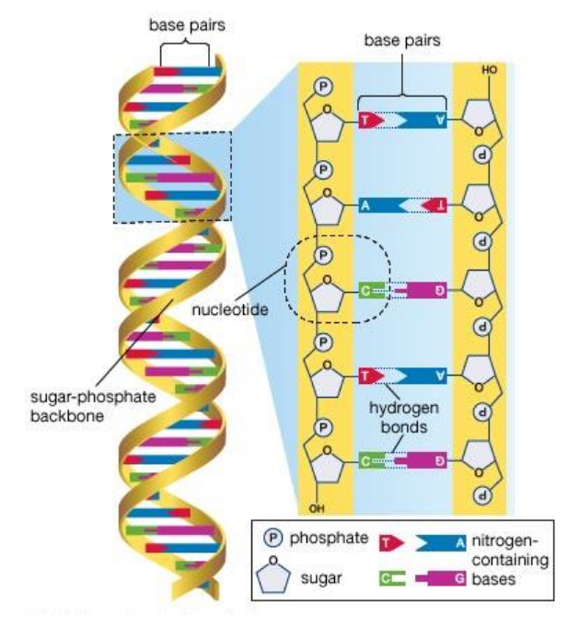
DNA
DNA molecule a double helix formed from two complementary strands of nucleotides held together by hydrogen bonds between G-C and A-T base pairs and these nucleotides are composed of sugar phosphate group and are bind with each other with hydrogen bonds.
DNA Double helix

Slide 5
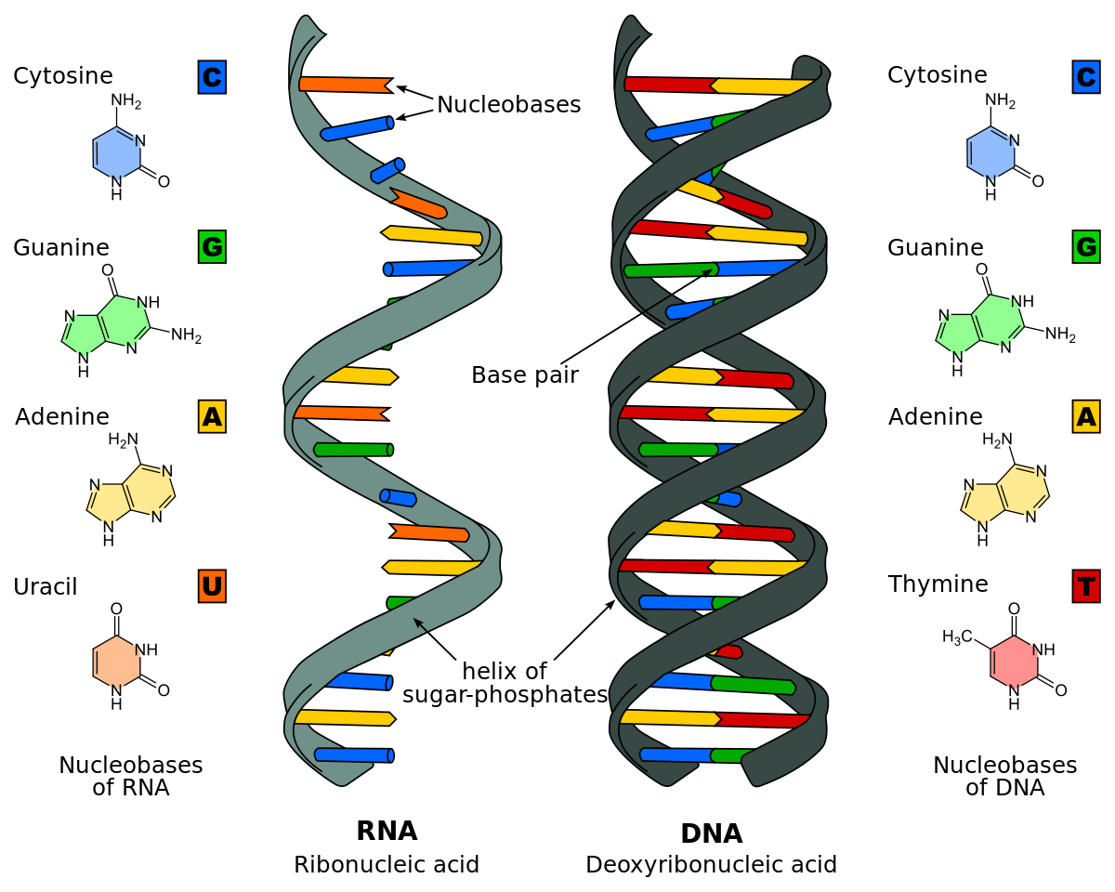
RNA
DNA → RNA

Slide 6
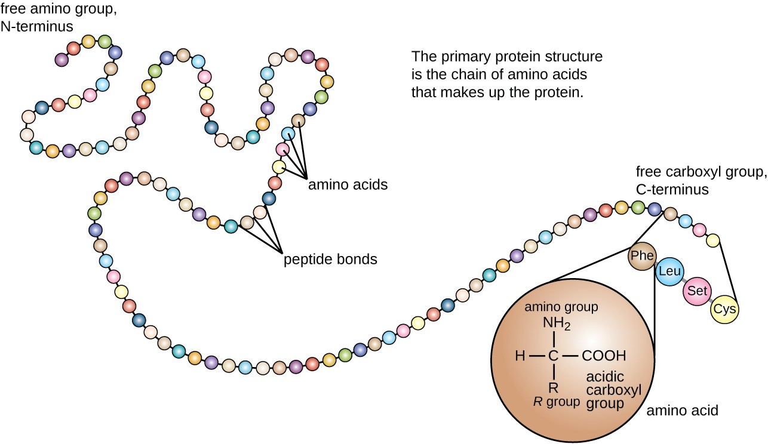
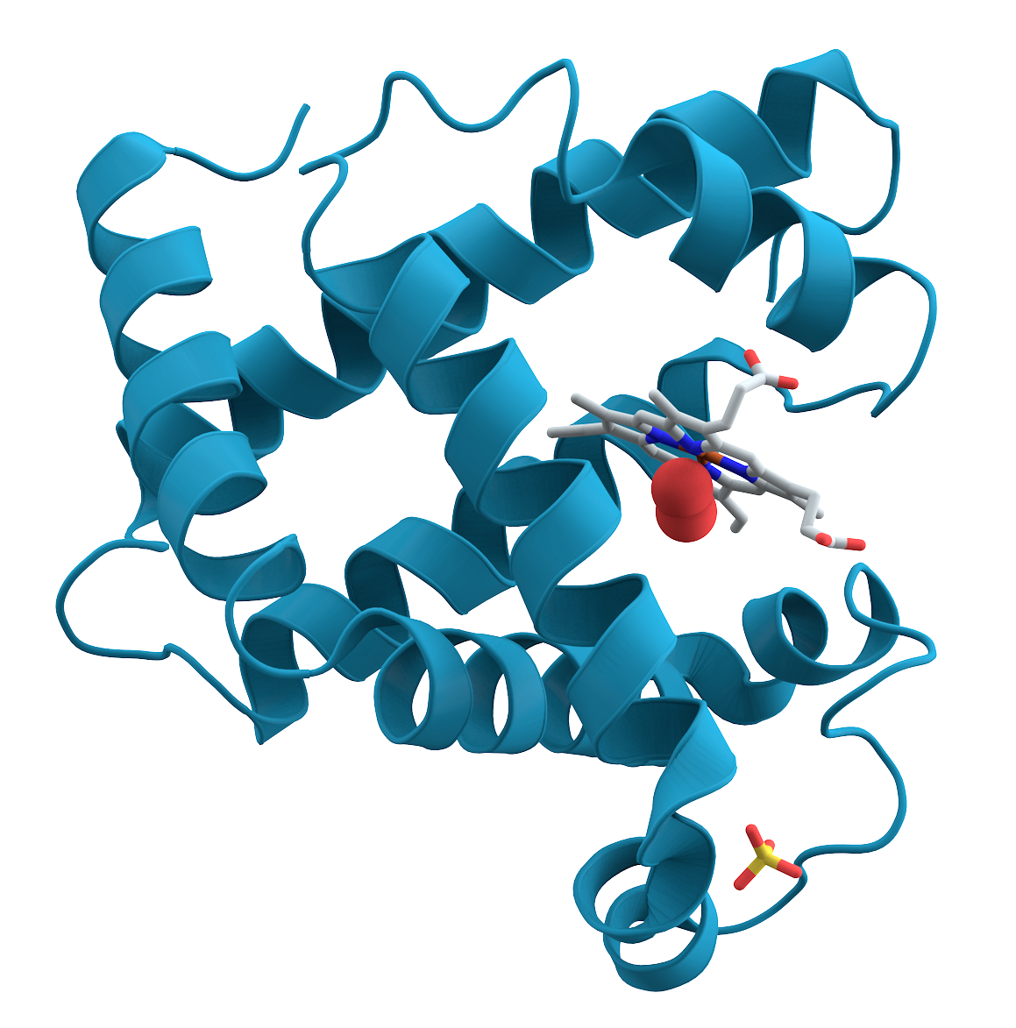
Proteins
RNA → Protein

Slide 7
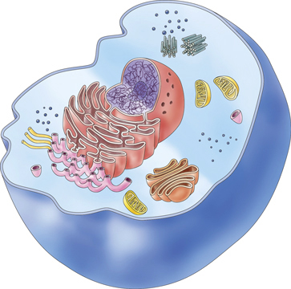
Cells

Slide 8
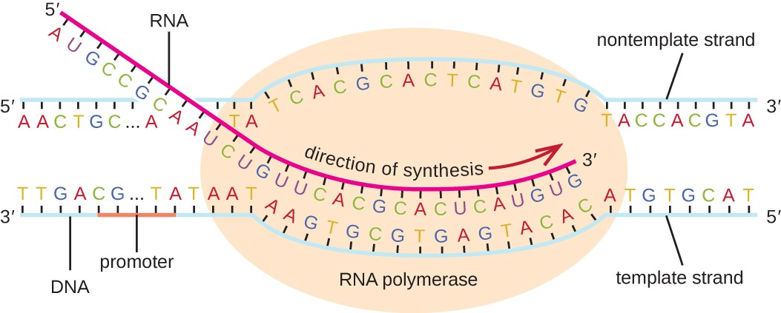
Transcription
Transcription is the process of copying a segment of DNA into RNA. The segments of DNA transcribed into RNA molecules that can encode proteins are said to produce messenger RNA (mRNA). Other segments of DNA are copied into RNA molecules called non-coding RNAs (ncRNAs).

Slide 9

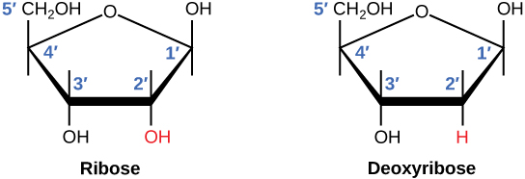
Nucleotide
Nucleotides are organic molecules consisting of a nucleoside and a phosphate.
RNA has Ribose sugar and DNA has de-oxyribose sugar.

Slide 10
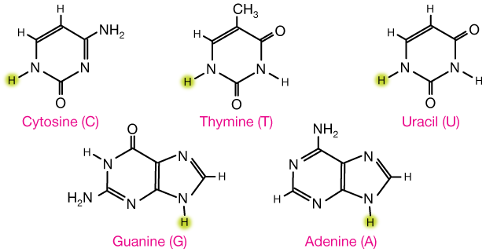
Nucleotide
Adenine and Guanine collectively called Purines while Cytosine, Uracil, and Thymine are called as Pyrimidine.

Slide 11
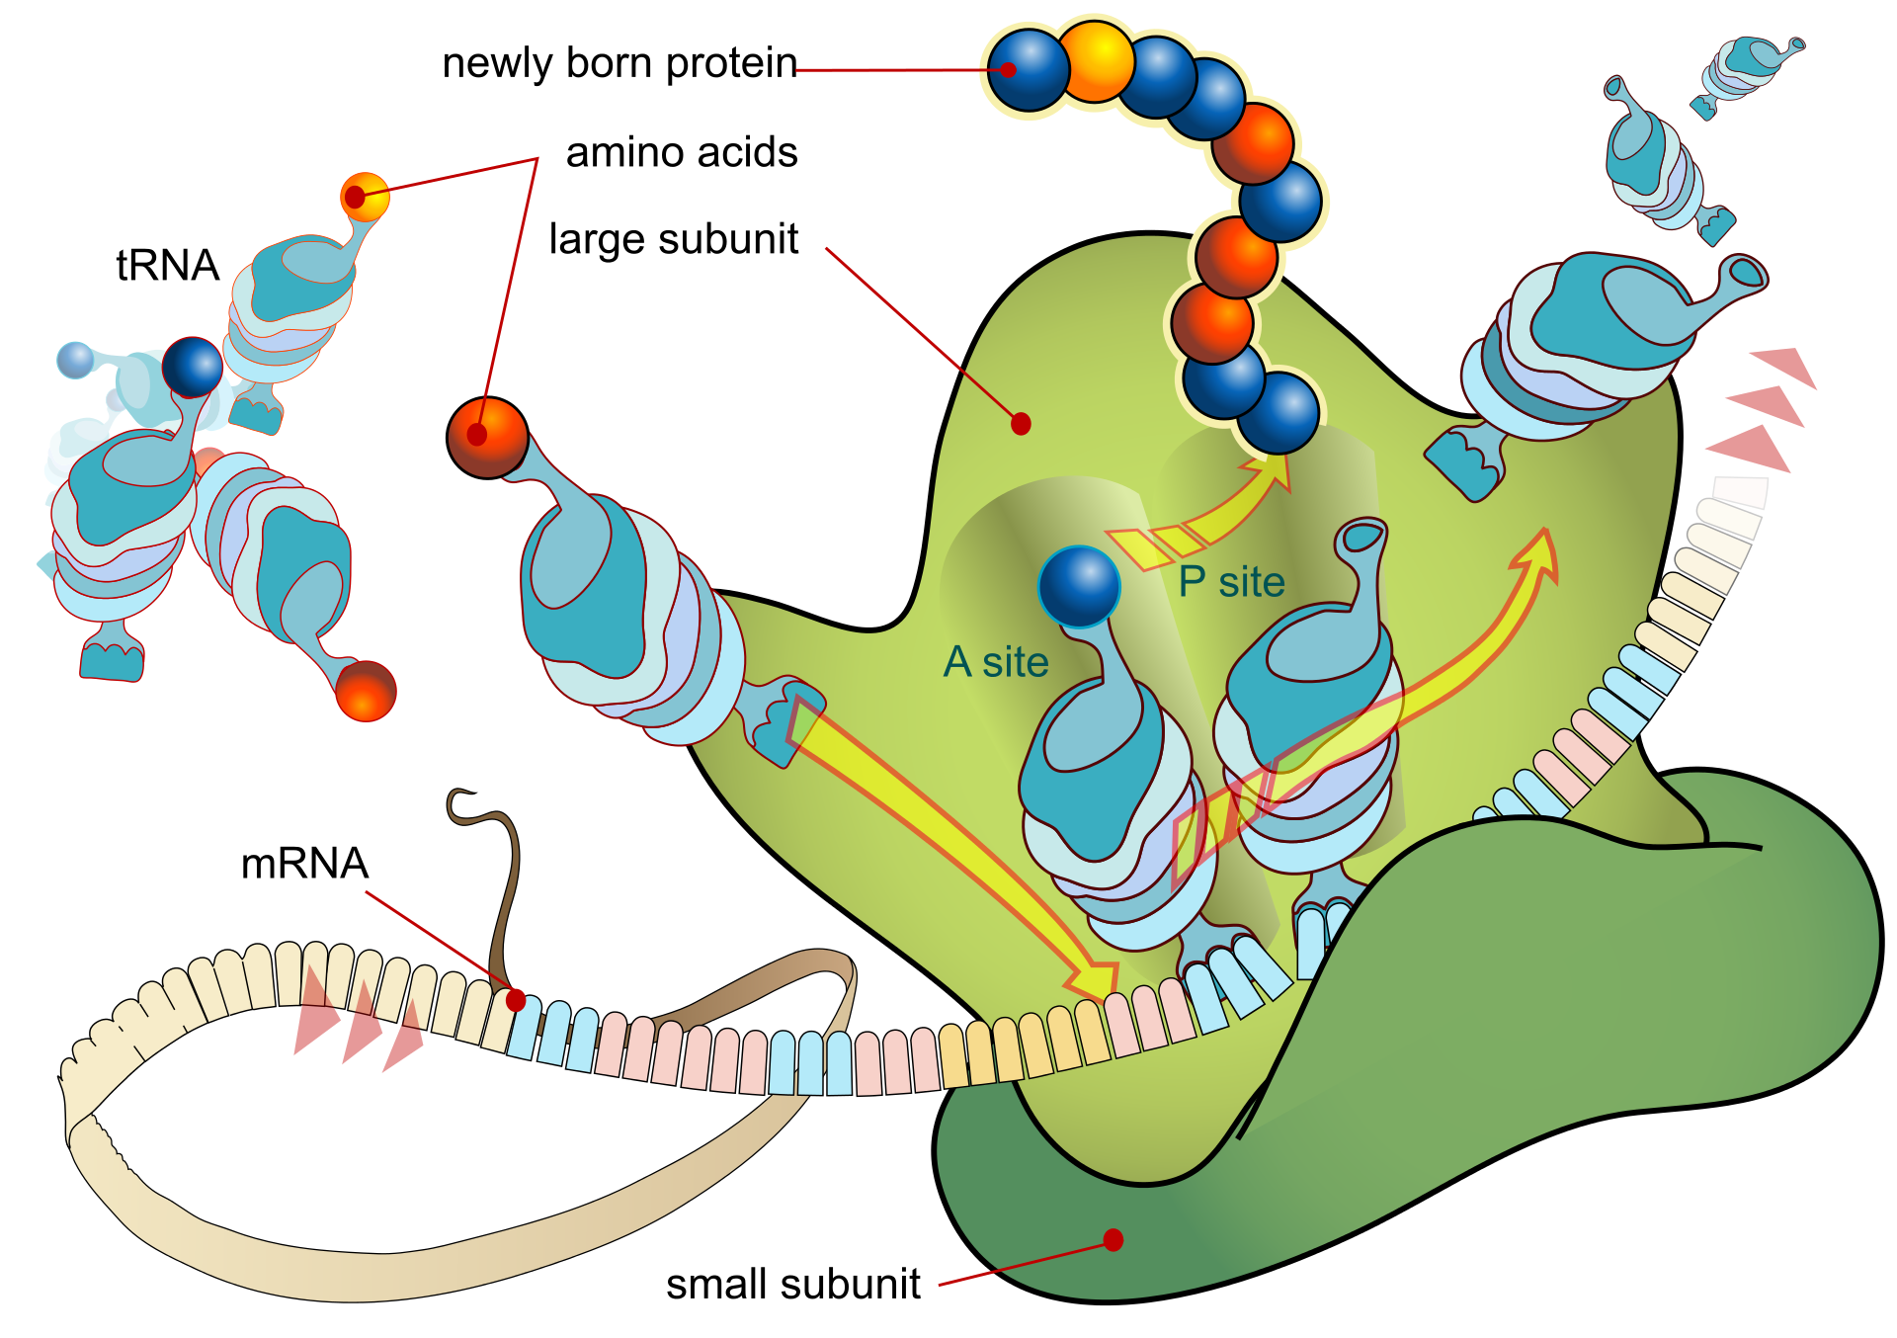
Translation
translation is the process in which ribosomes in the cytoplasm or endoplasmic reticulum synthesize proteins after the process of transcription of DNA to RNA in the cell's nucleus. The entire process is called gene expression. [Wikipedia]
Diagram showing the translation of mRNA and the synthesis of proteins by a ribosome

Slide 12
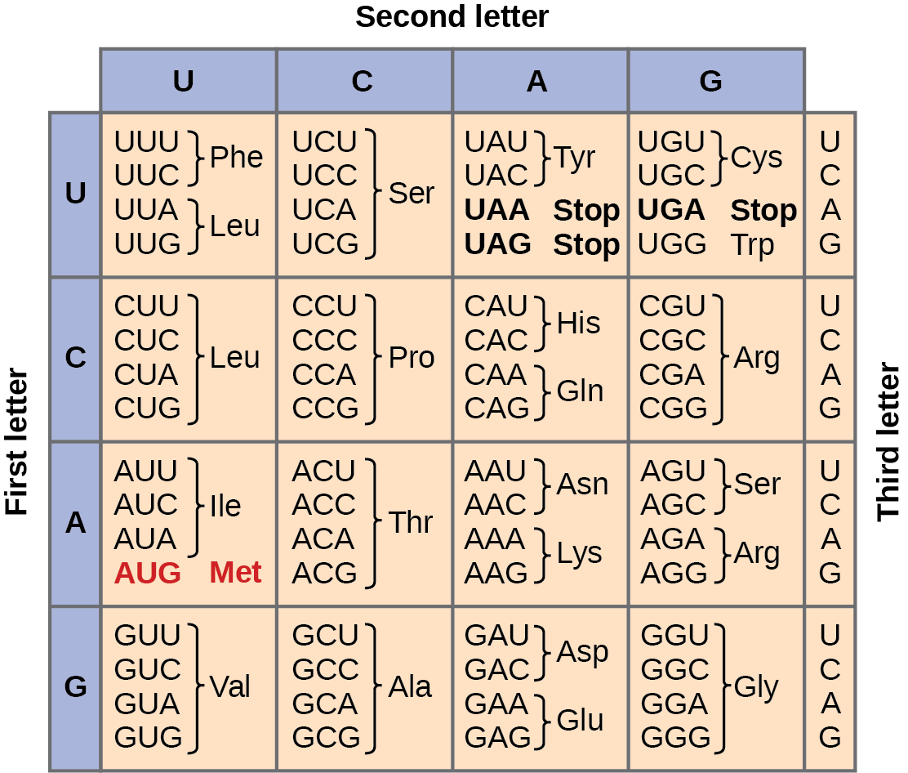
Codons

Slide 13
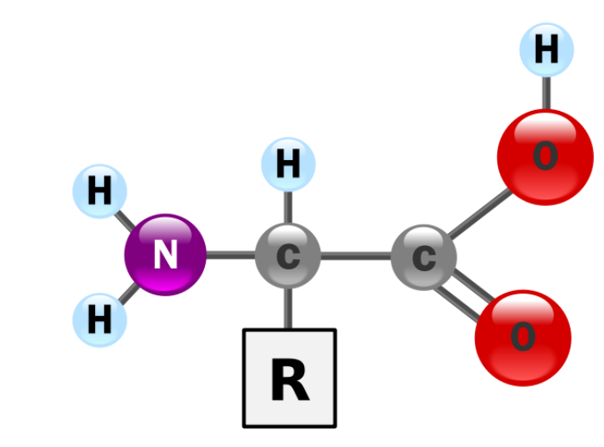
Amino acids
Amino acids are organic compounds that contain amino (–NH2) and carboxyl (–COOH) functional groups, along with a side chain (R group) specific to each amino acid.

Slide 14
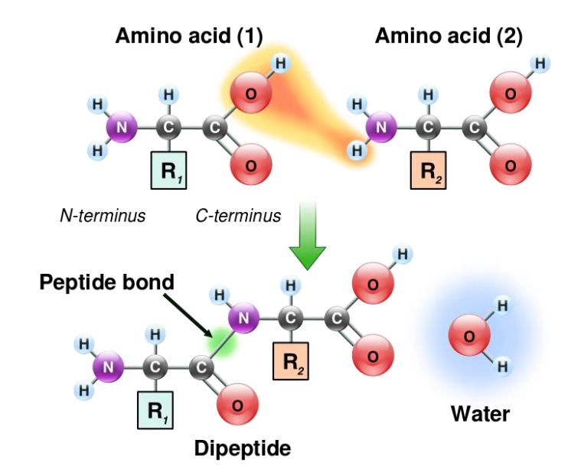
Amino acids

Slide 15
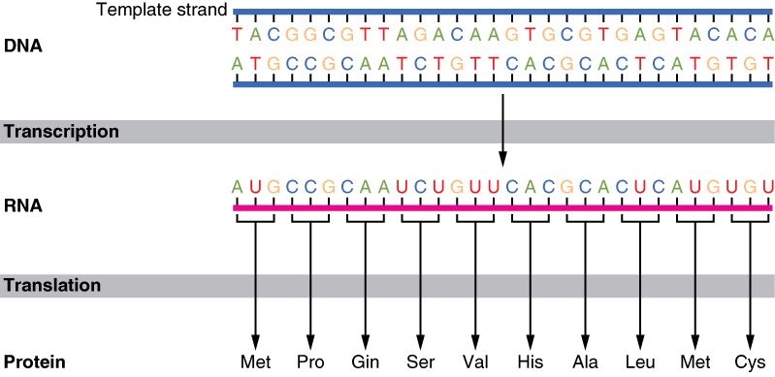
DNA→ RNA → Protein

Slide 16
Sequences Databases
GenBank (by NIH) for DNA and RNA sequences.
UniProt (by Uniprot Consortium) for protein sequences
Both databases are available online for public and researchers.

Slide 17
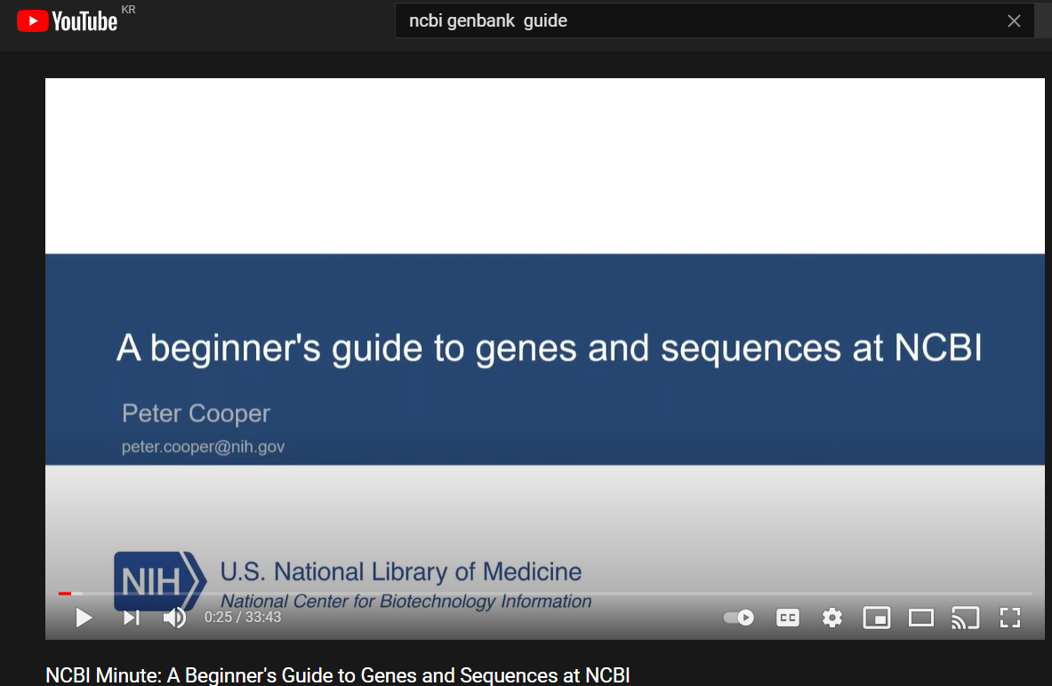
Gene bank
www.ncbi.nlm.nih.gov/genbank
https://www.youtube.com/watch?v=QIZ8QH6JcC8

Slide 18
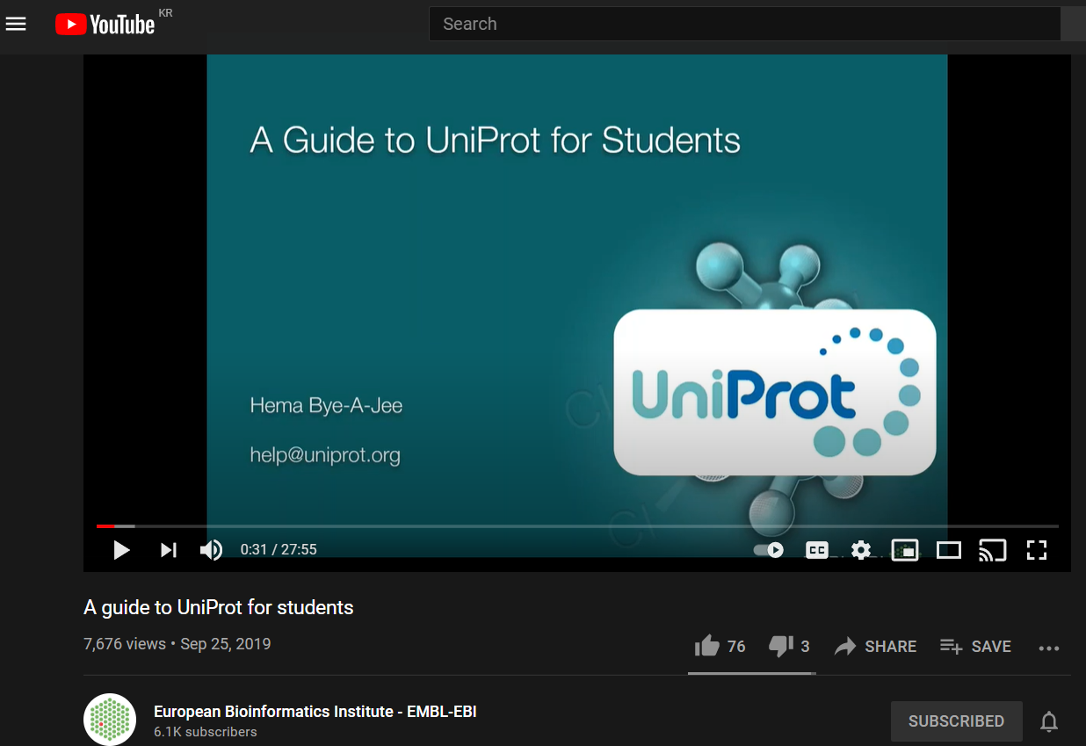
UNIPROT
www.Uniprot.org
https://www.youtube.com/watch?v=SUG-8-q4fN8

Slide 19
COMPARING SEQUENCES
DNA and proteins are coded for by chemicals that can be represented by one-letter codes. This makes the comparison of different DNA or protein sequences possible and aids in identifying
regions of similarity that may show functional, structural between the sequences.

Slide 20
COMPARING SEQUENCES
ACCTACGGATC
ACCTA
ACGTA
ACCTT
ACCTACGGATC

Slide 21
COMPARING SEQUENCES
Similarity (Exact matching)
ANCEQZINFB
ANCEQZINFB
100% matching
Differences (No exact matching)
ANCEQZINFB
ANCEQAINFB

Slide 22
Differences in sequences
Regular expression
Signature sequences
PROSITE pattern database

Slide 23
PROSITE pattern database
F-X(10)-R-E-X(72,86)-R-D-X-K-X(9)-C for MAP kinase
“-” separate amino acids
“X” any amino acid
Bracketed numbers length of a residue
(num1, num2): range of repetition in range num1 to num2.
https://prosite.expasy.org/

Slide 24
Pairwise sequence alignment
Pairwise Sequence Alignment is used to identify regions of similarity that may indicate functional, structural relationships between two biological sequences (protein or nucleic acid). http://www.ebi.ac.uk/Tools/psa/

Slide 25
Pairwise Sequence Alignment
Global Alignment
It create an end-to-end alignment of the sequences to be aligned.
Local Alignment
It finds one, or more, alignments describing the most similar region(s) within the sequences to be aligned.
Why local alignment?
Because Local alignment have power to detect the smaller regions with high similarity and such matches are motifs or domains which remain hidden in case of protein function.

Slide 26
Pairwise Sequence Alignment
Advantages of local alignment:
We can compare the different length sequences
Conserved domains can be determined from proteins
Common function features can be identified.

Slide 27
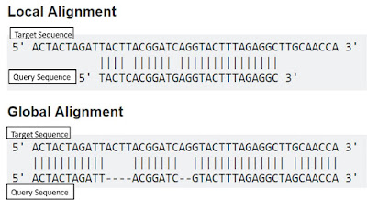

Slide 28
